Slide 1
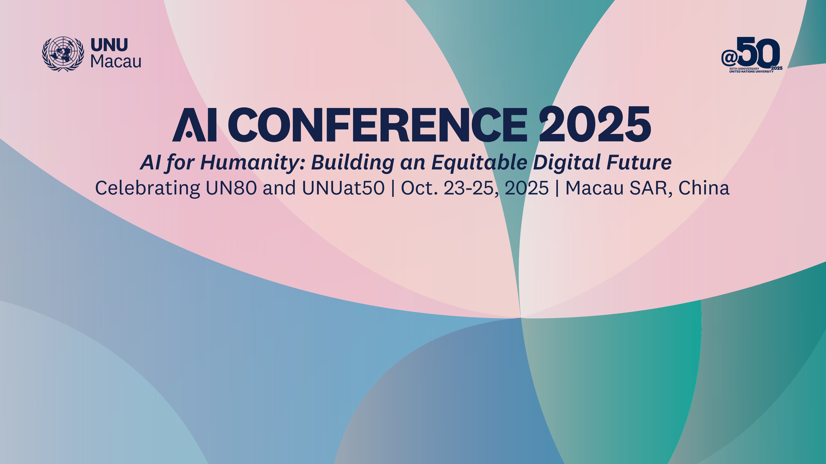

Slide 2

Technology for Community Inclusivity:
Successful Practices of Collaboration among the Government, Institutions and Communities
AI + Bridging the Gap | Presenter: Lei He
Team member：Tianxiao Qian; Lei He

Slide 3
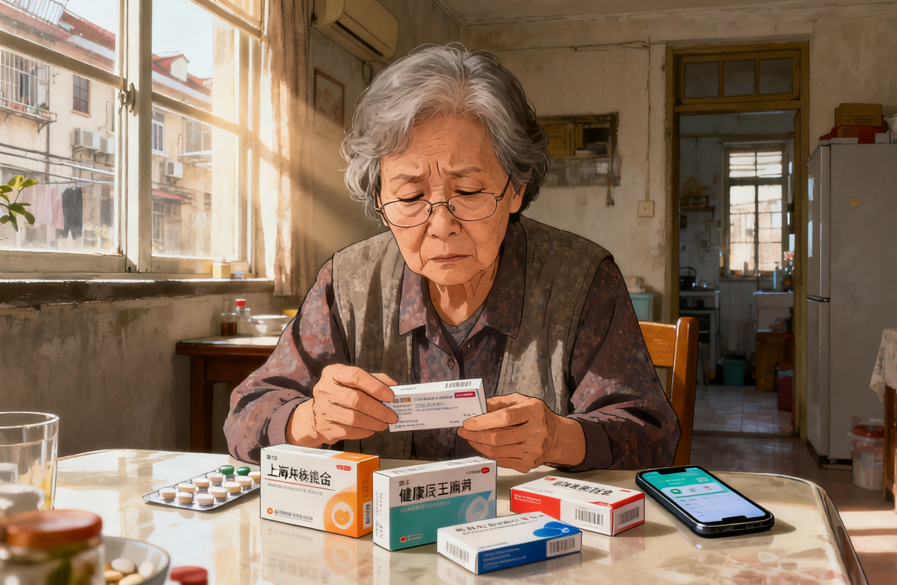
‘Was this little white tablet my morning diabetes pill, or the one for blood pressure at night?’
…
‘Maybe I’ll just ask my daughter at lunch.’

Slide 4
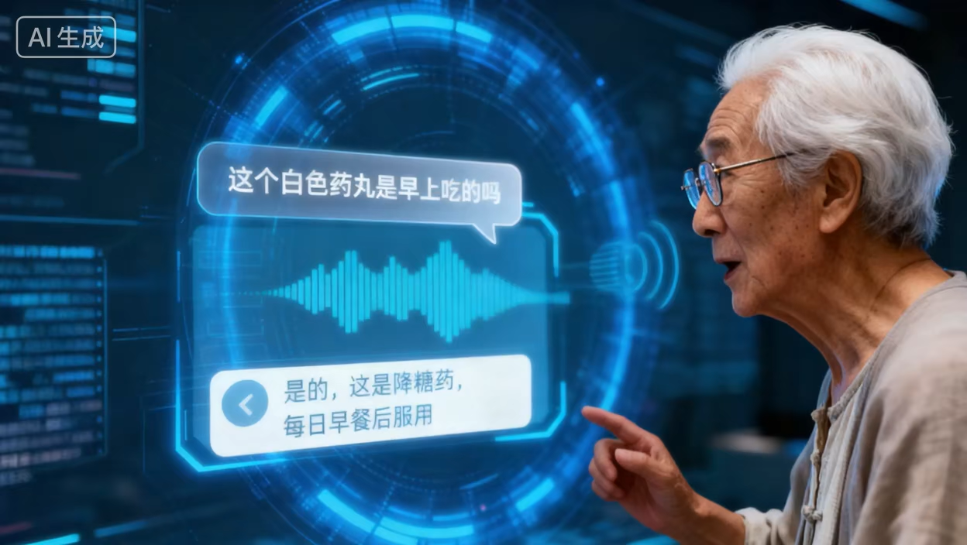
Knowledge Graph + AI Agent for Elderly Medication Reminder System

Slide 5
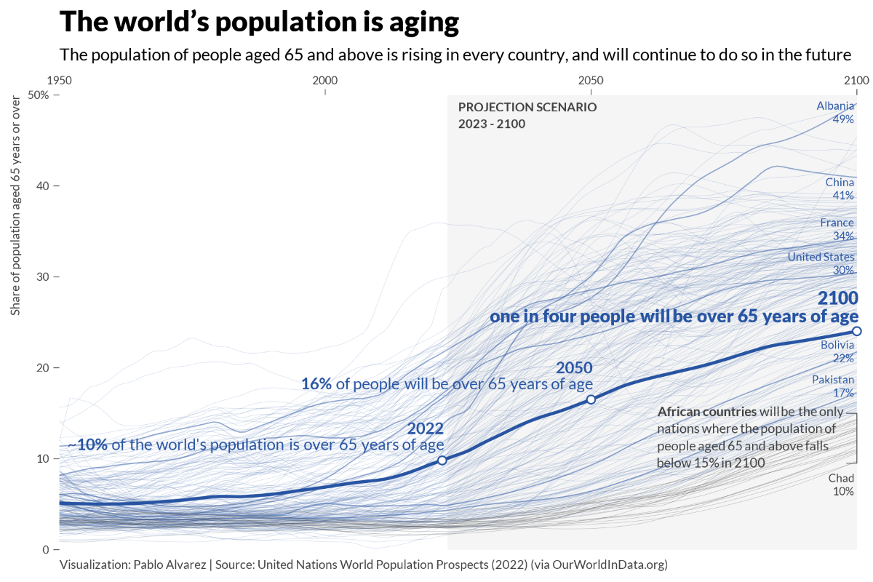
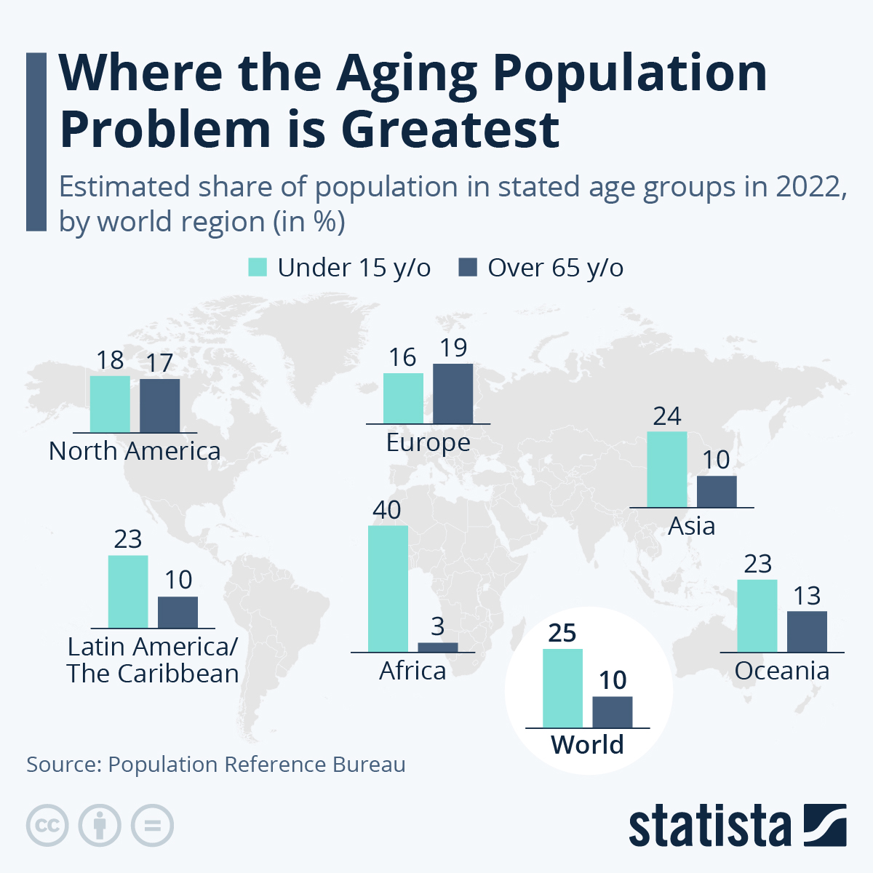
Research Background

Slide 6
Research Background
Problem | Description
Forgetting to take medication / drug names | Memory decline, cognitive overload
Forgetting dosage / administration | Confusion due to complex schedules, multiple forms
Limited digital literacy | Difficulty using apps or smart devices
Hearing / vision decline | Difficulty reading labels or hearing reminders
Polypharmacy / multiple medications | Increased confusion and risk of errors
Source:PubMed / PMC; ScienceDirect; BMC; CDC; UCSF

Slide 7
How can a system “understand” older adults’ fuzzy descriptions of medications, handle polypharmacy, and provide safe, interactive, real-time reminders?

Slide 8
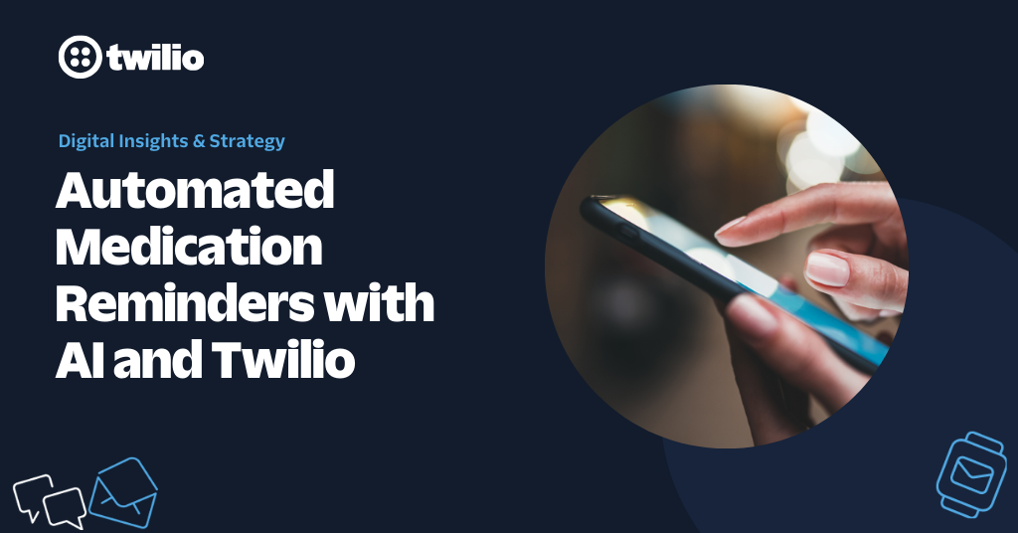
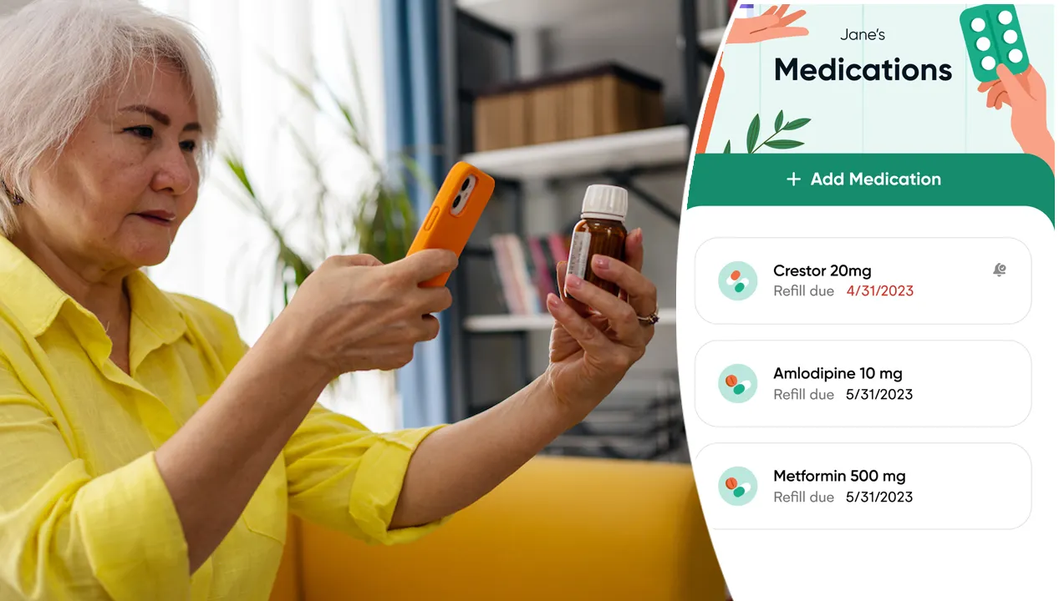
Related Work
1. Smart reminder devices / apps
Sensors + reminder modules to monitor adherence
Universal Medication Schedule (UMS) helps standardize reminders
Voice assistants / AI companions
Alexa / MedBuddy skills, smart TVs for elderly
Enable medication reminders, video calls, daily check-ins
3. AI / knowledge graph in healthcare
Knowledge graphs to map patient data + medications
AI agents for dialogue, recommendation, and reasoning
Reference: ScienceDirect, BMC; NY Post – AI companion for elderly; ScienceDirect Med-KGMA, Frontiers in AI

Slide 9
Beyond Simple Reminders — Our Work
Limitations of Existing Systems
Few truly understand how older adults actually speak or think about their medications.
They lack:
🗣️ Semantic understanding of vague or imprecise expressions
💊 Multi-drug reasoning and conflict detection
🔄 Interactive updates that evolve with user behavior
⏳ Long-term adaptation as health conditions change
Our Motivation
There is no low-cost, community-level system that integrates these functions for daily use.
In reality, seniors often use ambiguous, conversational language when talking about medicines —“the red capsule I took last week.”
A knowledge-graph–driven interactive AI agent that can understand, reason, and continuously learn from each user.

Slide 10
System Architecture(I): Overall Workflow
Intent Recognition → Identify the user’s intention from natural language (e.g., “Which pill should I take now?”)
Entity Extraction → Extract user-related and medication-related information (name, color, dosage, time).
LLM Matching & Reasoning → The large language model interprets the query and connects it to relevant knowledge-graph nodes.
Dialogue Management → If information is incomplete, the system asks follow-up questions through multi-turn conversation.
Answer Generation & Knowledge Update → Provide an accurate, personalized response. → Use structured prompts to update or refine the knowledge graph in real time.

Slide 11
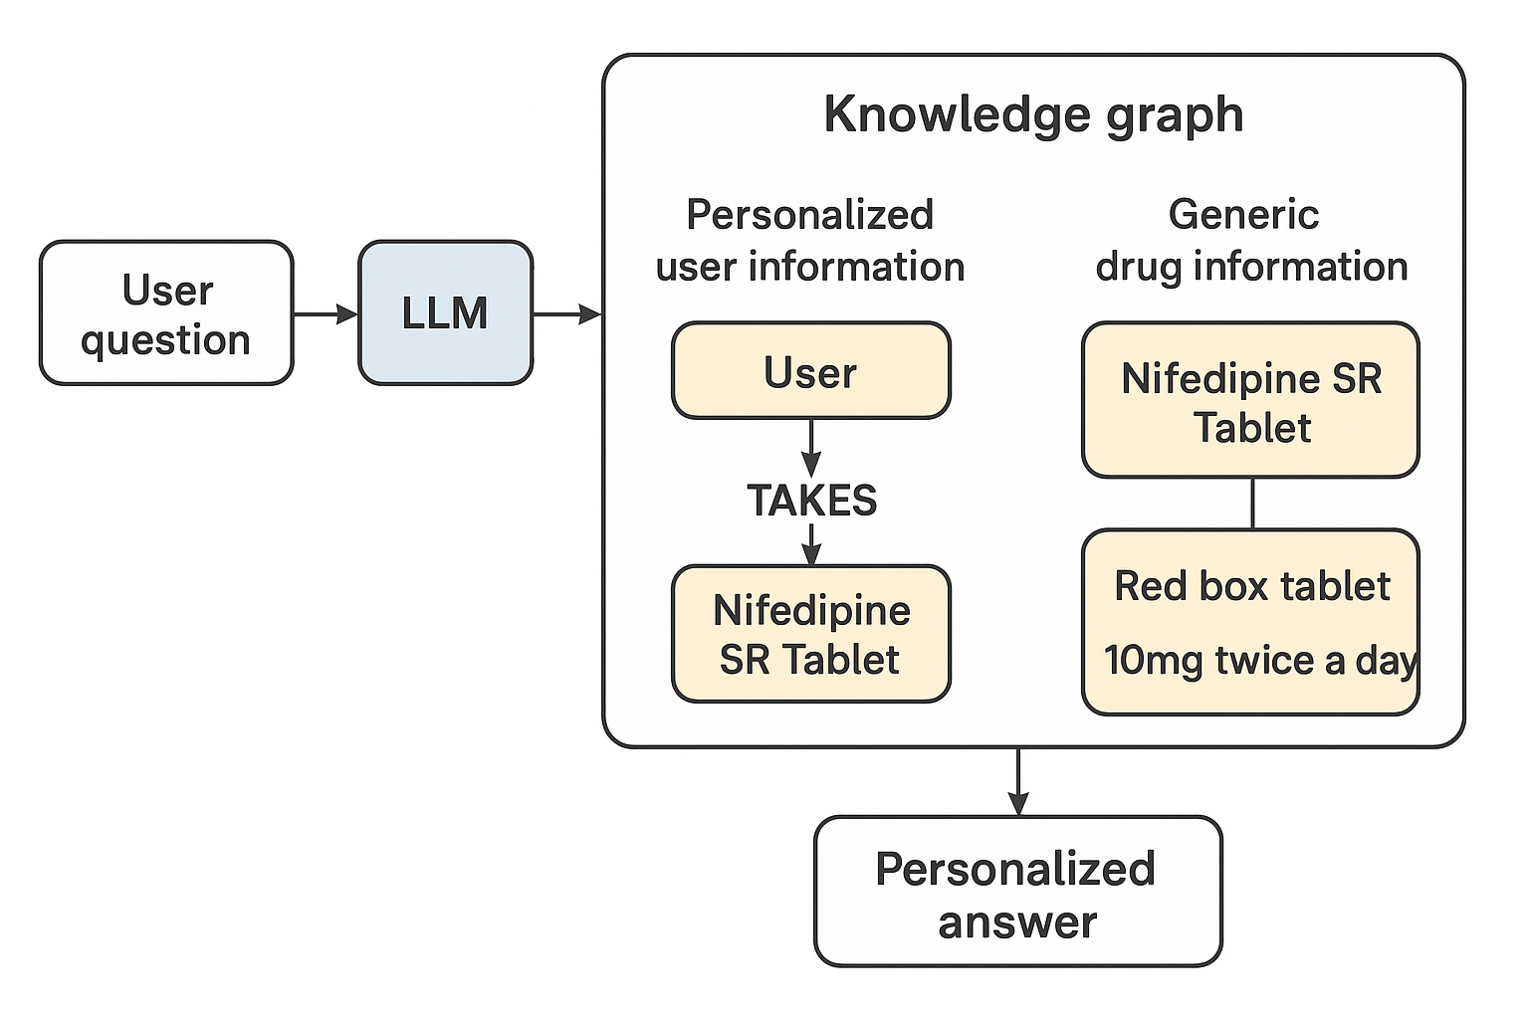
System Architecture(II): Knowledge Graph
Why a Knowledge Graph?
Enhances accuracy and traceability of medical information.
Links data across drugs, dosages, schedules, and user profiles.
Use intent recognition to narrow search scope — retrieve only entities related to the user or mentioned drugs.
How It’s Built
General Knowledge Layer: domain-level data – drug names, appearances, interactions.
Personalized Knowledge Layer: user-specific data – prescriptions, allergies, history.
AI Agent Framework
Combines Language Chain (logical flow of LLM prompts) + Language Graph (structured knowledge context).
Enables understanding + reasoning + dialogue generation.

Slide 12
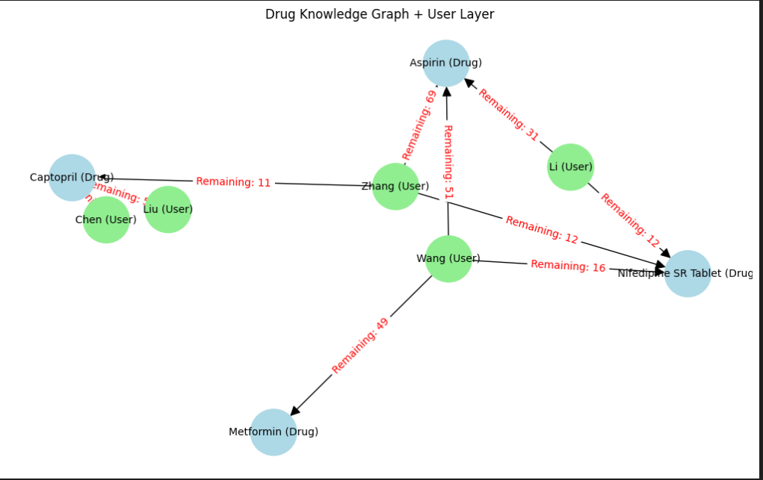
System Architecture(II): Knowledge Graph
Why a Knowledge Graph?
Links data across drugs, dosages, schedules, and user profiles.
Use intent recognition to narrow search scope — retrieve only entities related to the user or mentioned drugs.

Slide 13
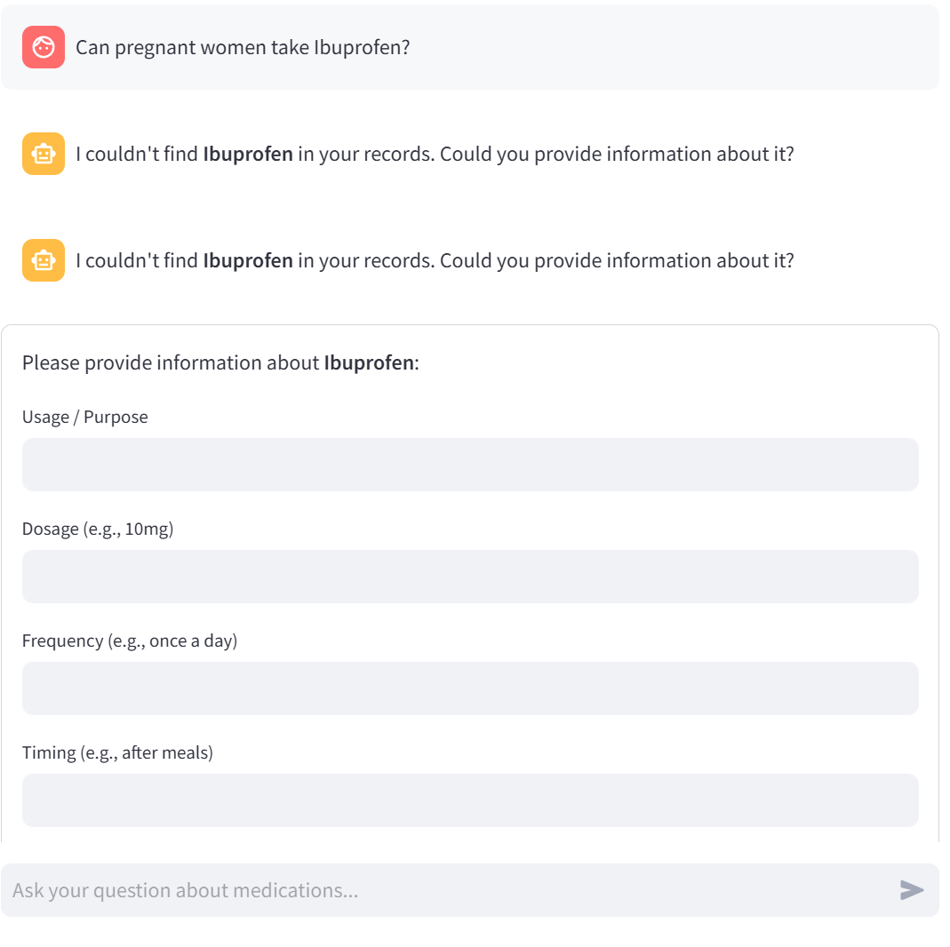
Case Demonstration
See how our system works! ➡️
" What medications am I currently taking? "
"How many times a day should I take the red box tablet?"
"What is the small blue tablet used for?“
"Can pregnant women take Captopril?"
"When is my next refill?"

Slide 14
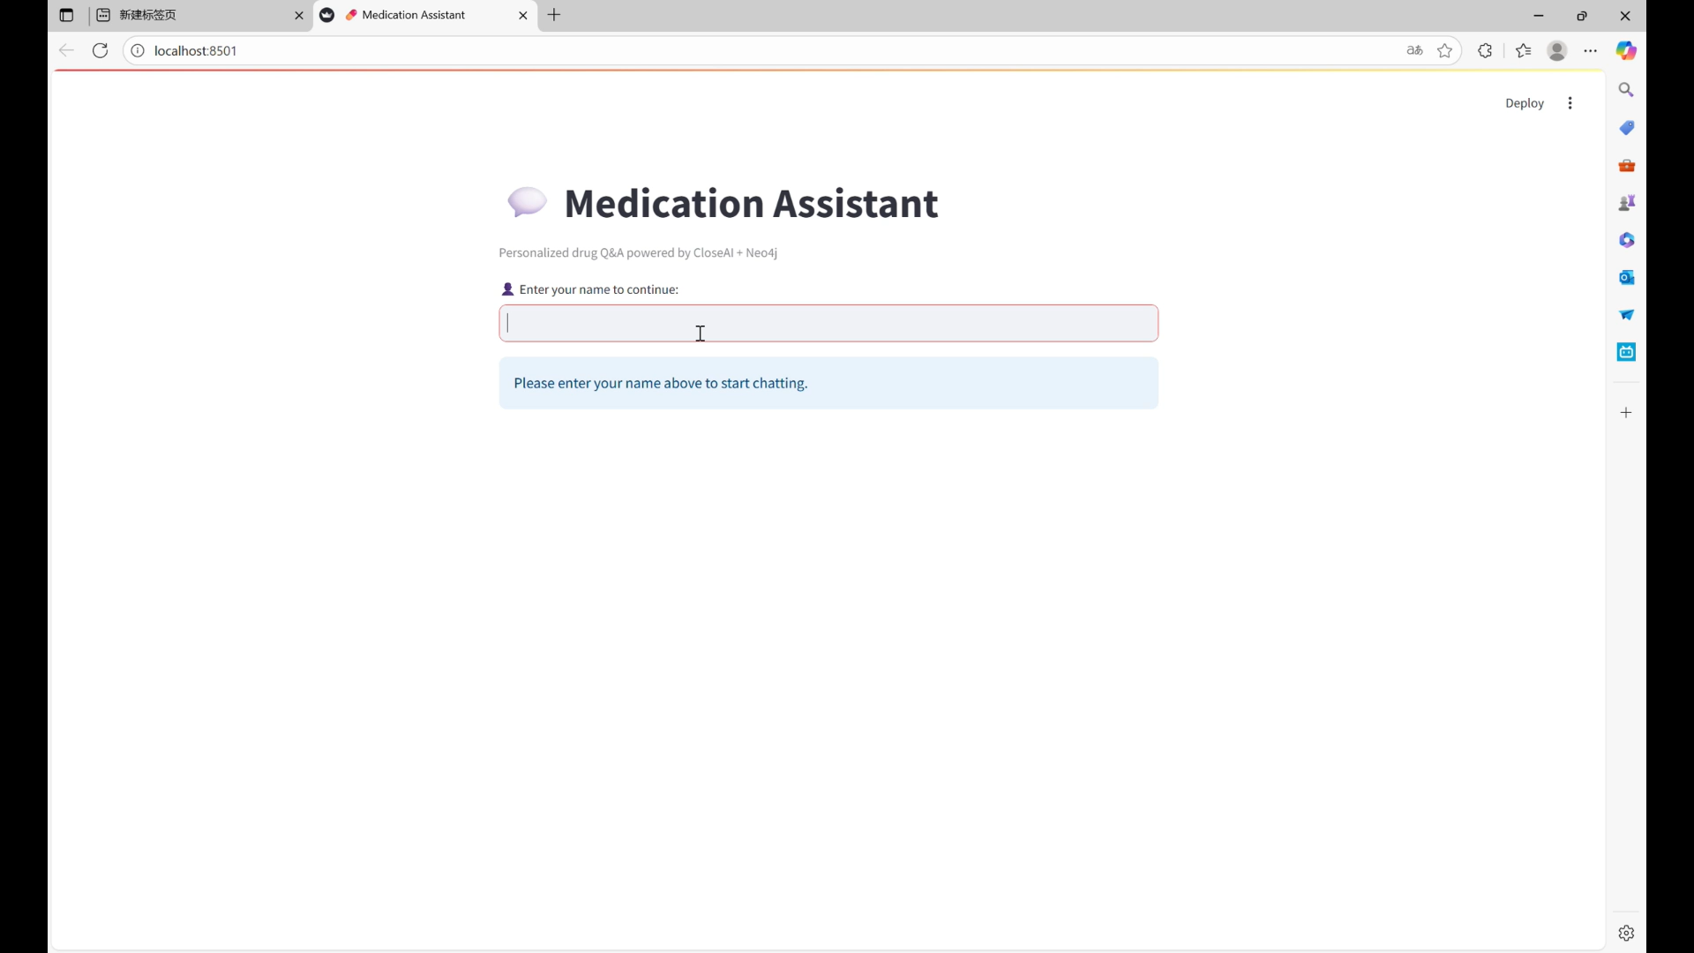

Slide 15
Key Innovations & Contributions
Fuzzy Matching & Intent Detection → Understands vague or incomplete user expressions like “the red pill I took last night”.
Dual-Layer Knowledge Graph → Combines general medical knowledge with personalized patient data for precise reasoning.
Interactive AI Agent / Multi-turn Dialogue
→ ‘Do you mean the white tablet for blood pressure or the yellow one for cholesterol?’ → Engages in natural, back-and-forth conversations to clarify and refine user input.
Automated Updates & Long-term Adaptation → Continuously learns from each interaction and updates the knowledge graph in real time.

Slide 16
Future Work
Enhanced companionship: AI can chat, offer cognitive games, emotional support
Multi modal input/output: Voice, images, TV interface
Deployment & clinical trials: Integration with hospital / pharmacy systems
Privacy & safety: Secure storage, error handling, responsible AI design

Slide 17


